Slide 1
Introduction to AI

Slide 2
AI VS ML VS DL VS DS
AI enables the machine to think
Statistical tools to explore
and analyze the data
Supervised
Unsupervised
Reinforcement
Multi neural
n/w architecture
ANN, CNN, RNN
AI
ML
DL
DS
Statistics
Probability
Linear Algebra

Slide 3
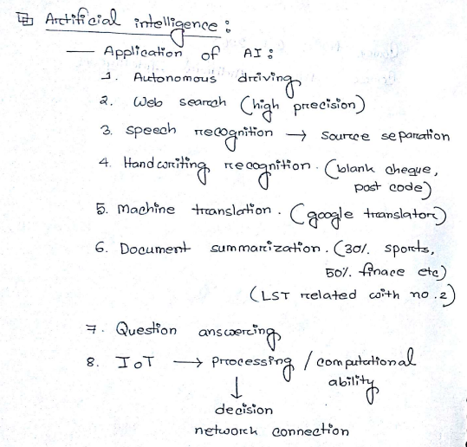
Applications of AI in our daily life

Slide 4
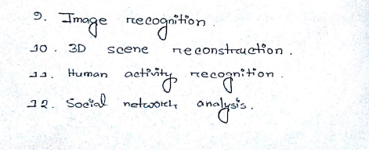

Applications of AI in our daily life(cont.)

Slide 5
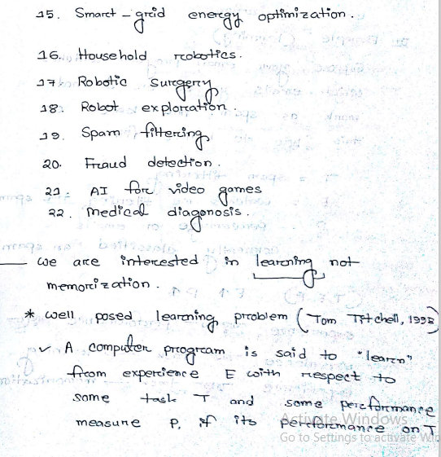

Applications of AI in our daily life(cont.)

Slide 6
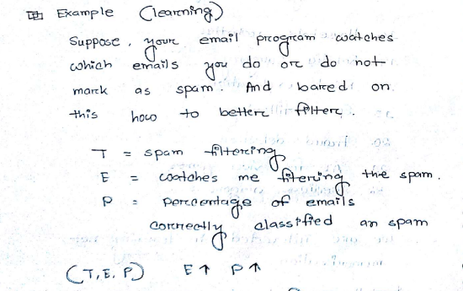
Learning examples

Slide 7
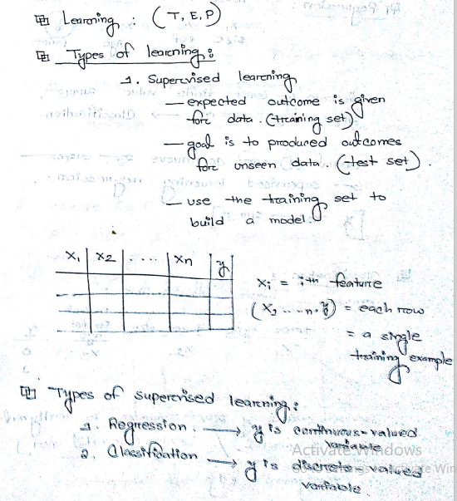
Types of learning

Slide 8
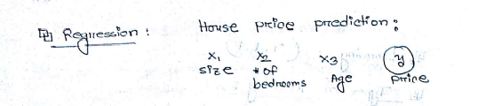
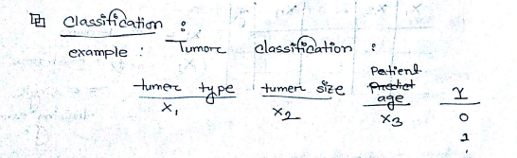
Types of learning(Cont.)

Slide 9
Types of learning(Cont.)
Size |  |  | Price
1000 |  |  | 10lac
2000 |  |  | 18lac
3000 |  |  | 27lac

Slide 10
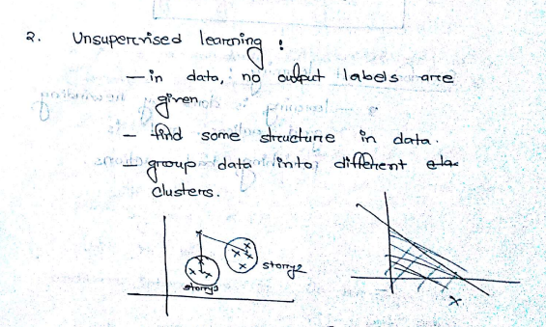
Types of learning(Cont.)

Slide 11
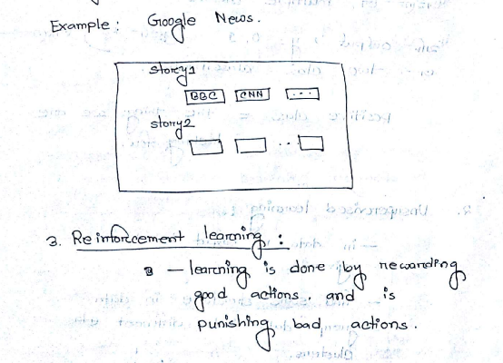
Types of learning(Cont.)

